Slide 1
E-Business and E-Commerce

Slide 2
Overview of E-Business and E-Commerce
Business-to-Consumer (B2C) Electronic Commerce
Business-to-Business (B2B) Electronic Commerce
Ethical and Legal Issues in E-Business

Slide 3
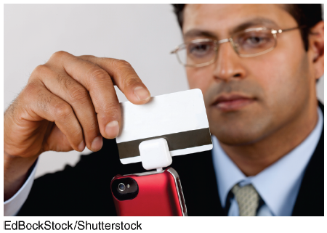
Swipely
Describe the advantages that Swipely offers merchants that help it maintain a competitive advantage in the marketplace.
Refer back to Chapter 2. Does Swipely function as a strategic information system for a merchant? Why or why not?

Slide 4
9.1
Overview of E-Business and E-Commerce
Definitions and Concepts
Types of E-Commerce
Major E-Commerce Mechanisms
Electronic Payment Mechanisms
Benefits and Limitations of E-Commerce

Slide 5
Definitions and Concepts
Electronic Commerce (EC or e-commerce)
Electronic Business (e-business)
Degree of Digitization
Brick-and-Mortar Organizations
Virtual (or pure-play) Organizations
Clicks-and-Mortar (or Clicks-and-Bricks)
Notes:
Electronic Commerce (EC or e-commerce): the process of buying, selling, transferring, or exchanging products, services, or information via computer networks, including the Internet.
Electronic Business (e-business): in addition to the buying and selling of goods and services, e-business (a broader concept) refers to servicing customers, collaborating with business partners, and performing electronic transactions within an organization.
Degree of Digitization: the extent to which the commerce has been transformed from physical to digital which can relate to both the product or service being sold and the delivery agent or intermediary. In other words, the product can be either physical or digital, and the delivery agent can also be either physical or digital.
Brick-and-Mortar Organizations: organizations that exist as purely physical organizations.
Virtual (or pure-play) Organizations: all dimensions of the organization are digital and they engage in pure electronic commerce only.
Clicks-and-Mortar (or Clicks-and-Bricks): organizations that are partial electronic commerce (EC) combining both virtual and physical dimensions.

Slide 6
Definitions and Concepts
Electronic Commerce (EC or e-commerce): the process of buying, selling, transferring, or exchanging products, services, or information via computer networks, including the Internet.
Electronic Business (e-business): in addition to the buying and selling of goods and services, e-business (a broader concept) refers to servicing customers, collaborating with business partners, and performing electronic transactions within an organization.
Notes:
Electronic Commerce (EC or e-commerce): the process of buying, selling, transferring, or exchanging products, services, or information via computer networks, including the Internet.
Electronic Business (e-business): in addition to the buying and selling of goods and services, e-business (a broader concept) refers to servicing customers, collaborating with business partners, and performing electronic transactions within an organization.
Degree of Digitization: the extent to which the commerce has been transformed from physical to digital which can relate to both the product or service being sold and the delivery agent or intermediary. In other words, the product can be either physical or digital, and the delivery agent can also be either physical or digital.
Brick-and-Mortar Organizations: organizations that exist as purely physical organizations.
Virtual (or pure-play) Organizations: all dimensions of the organization are digital and they engage in pure electronic commerce only.
Clicks-and-Mortar (or Clicks-and-Bricks): organizations that are partial electronic commerce (EC) combining both virtual and physical dimensions.

Slide 7
Definitions and Concepts
Degree of Digitization:
The degree of digitization is the extent to which the commerce has been transformed from physical to digital.
This concept can relate to both the product or service being sold and the delivery agent or intermediary.
In other words, the product can be either physical or digital, and the delivery agent can be either physical or digital.
Notes:
Electronic Commerce (EC or e-commerce): the process of buying, selling, transferring, or exchanging products, services, or information via computer networks, including the Internet.
Electronic Business (e-business): in addition to the buying and selling of goods and services, e-business (a broader concept) refers to servicing customers, collaborating with business partners, and performing electronic transactions within an organization.
Degree of Digitization: the extent to which the commerce has been transformed from physical to digital which can relate to both the product or service being sold and the delivery agent or intermediary. In other words, the product can be either physical or digital, and the delivery agent can also be either physical or digital.
Brick-and-Mortar Organizations: organizations that exist as purely physical organizations.
Virtual (or pure-play) Organizations: all dimensions of the organization are digital and they engage in pure electronic commerce only.
Clicks-and-Mortar (or Clicks-and-Bricks): organizations that are partial electronic commerce (EC) combining both virtual and physical dimensions.

Slide 8
Definitions and Concepts
Brick-and-Mortar Organizations: organizations that exist as purely physical organizations.
The term "brick-and-mortar" refers to a traditional street-side business that offers products and services to its customers face-to-face in an office or store that the business owns or rents.
The local grocery store and the corner bank are examples of brick-and-mortar companies.
Notes:
Electronic Commerce (EC or e-commerce): the process of buying, selling, transferring, or exchanging products, services, or information via computer networks, including the Internet.
Electronic Business (e-business): in addition to the buying and selling of goods and services, e-business (a broader concept) refers to servicing customers, collaborating with business partners, and performing electronic transactions within an organization.
Degree of Digitization: the extent to which the commerce has been transformed from physical to digital which can relate to both the product or service being sold and the delivery agent or intermediary. In other words, the product can be either physical or digital, and the delivery agent can also be either physical or digital.
Brick-and-Mortar Organizations: organizations that exist as purely physical organizations.
Virtual (or pure-play) Organizations: all dimensions of the organization are digital and they engage in pure electronic commerce only.
Clicks-and-Mortar (or Clicks-and-Bricks): organizations that are partial electronic commerce (EC) combining both virtual and physical dimensions.

Slide 9
Definitions and Concepts
Virtual (or pure-play) Organizations: all dimensions of the organization are digital and they engage in pure electronic commerce only.
Clicks-and-Mortar (or Clicks-and-Bricks): organizations that are partial electronic commerce (EC) combining both virtual and physical dimensions.

Slide 10
Definitions and Concepts
Brick-and-Mortar Organizations: organizations that exist as purely physical organizations.
The term "brick-and-mortar" refers to a traditional street-side business that offers products and services to its customers face-to-face in an office or store that the business owns or rents. The local grocery store and the corner bank are examples of brick-and-mortar companies.
Virtual (or pure-play) Organizations: all dimensions of the organization are digital and they engage in pure electronic commerce only.
Clicks-and-Mortar (or Clicks-and-Bricks): organizations that are partial electronic commerce (EC) combining both virtual and physical dimensions.
Notes:
Electronic Commerce (EC or e-commerce): the process of buying, selling, transferring, or exchanging products, services, or information via computer networks, including the Internet.
Electronic Business (e-business): in addition to the buying and selling of goods and services, e-business (a broader concept) refers to servicing customers, collaborating with business partners, and performing electronic transactions within an organization.
Degree of Digitization: the extent to which the commerce has been transformed from physical to digital which can relate to both the product or service being sold and the delivery agent or intermediary. In other words, the product can be either physical or digital, and the delivery agent can also be either physical or digital.
Brick-and-Mortar Organizations: organizations that exist as purely physical organizations.
Virtual (or pure-play) Organizations: all dimensions of the organization are digital and they engage in pure electronic commerce only.
Clicks-and-Mortar (or Clicks-and-Bricks): organizations that are partial electronic commerce (EC) combining both virtual and physical dimensions.

Slide 11
Definitions and Concepts
Purchasing a shirt at Walmart Online or a book from Amazon.com is an example of partial EC because the merchandise, although bought and paid for digitally, is physically delivered by company.
In contrast, buying an e-book from Amazon.com or a software product from Buy.com constitutes pure EC because the product itself as well as its delivery, payment, and transfer are digital.
To avoid confusion, we use the term electronic commerce to denote both pure and partial EC.

Slide 12
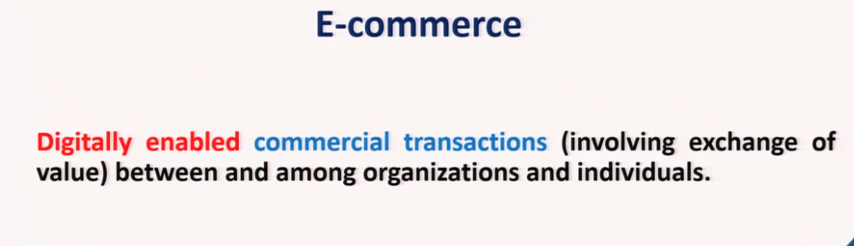

Slide 13
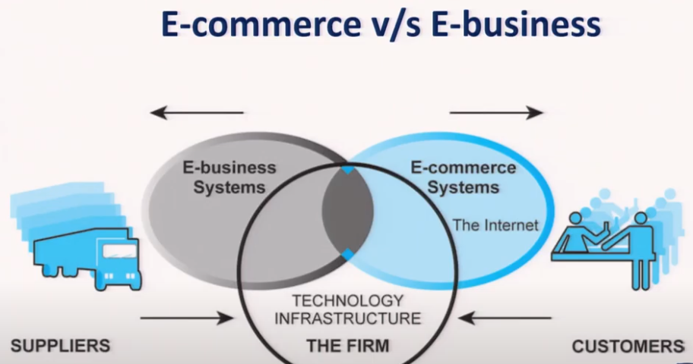

Slide 14
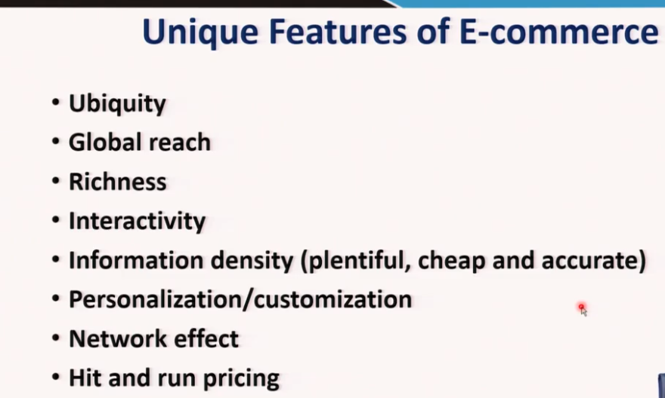

Slide 15
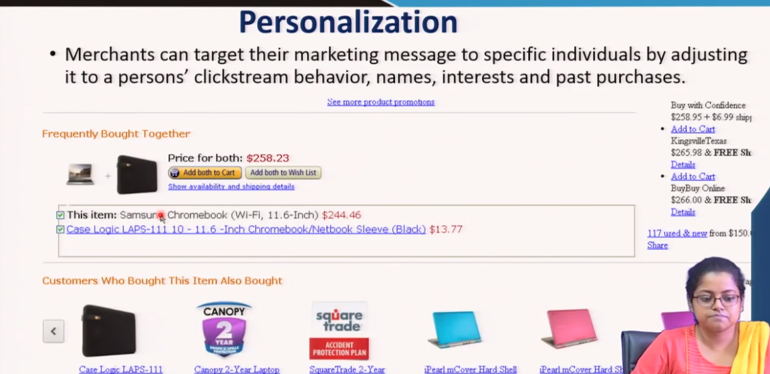
Amazon, Flipcart

Slide 16
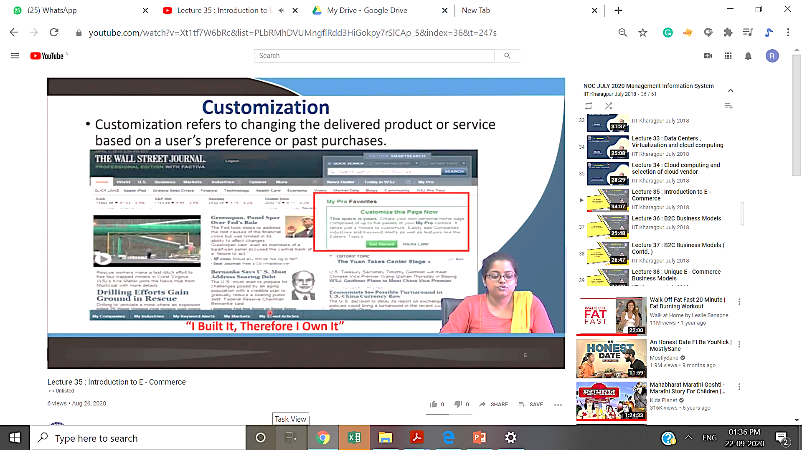
Customize page as per your own interest

Slide 17
’S ABOUT BUSINESS 9.1
FlightCar
What are possible disadvantages of FlightCar’s business model for its customers? Provide specific examples to support your answer.
Can FlightCar survive in its marketplace? Why or why not? Support your answer.
Would you allow FlightCar to rent your car while you were traveling? Why or why not? Support your answer. Does your answer to this question have any bearing on your answer to Question 2?

Slide 18
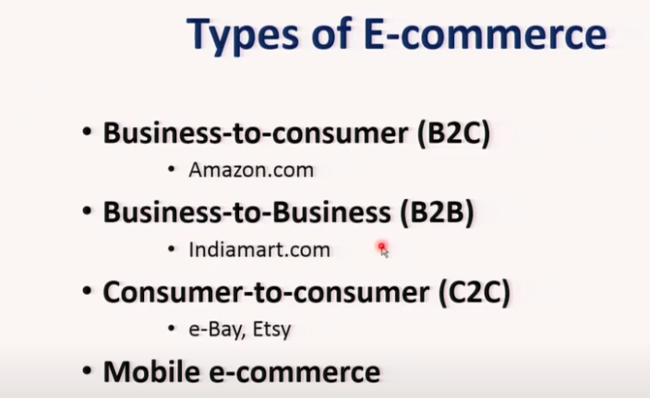

Slide 19
Types of E-Commerce
Business-to-Consumer (B2C)
Business-to-Business (B2B)
Consumer-to-Consumer (C2C)
Business-to-Employee (B2E)
E-government
Government-to-Citizen (G2C)
Government-to-Business (G2B)
Mobile Commerce (m-commerce)
Notes:
Business-to-Consumer (B2C): the sellers are organizations, and the buyers are individuals.
Business-to-Business (B2B): both the sellers and the buyers are business organizations. B2B comprises the vast majority of EC volume.
Consumer-to-Consumer (C2C): an individual sells products or services to other individuals.
Business-to-Employee (B2E): an organization uses EC internally to provide information and services to its employees.
E-government: E-government is the use of Internet technology in general and e-commerce in particular to deliver information and public services to citizens.
Government-to-Citizen (G2C): government to individual citizens.
Government-to-Business (G2B): G2B EC is much like B2B EC, usually with an overlay of government procurement regulations.
Mobile Commerce (m-commerce): e-commerce that is conducted entirely in a wireless environment.

Slide 20
Types of E-Commerce
Business-to-Consumer (B2C): the sellers are organizations, and the buyers are individuals.
Business-to-Business (B2B): both the sellers and the buyers are business organizations. B2B comprises the vast majority of EC volume.
Consumer-to-Consumer (C2C): an individual sells products or services to other individuals.
Notes:
Business-to-Consumer (B2C): the sellers are organizations, and the buyers are individuals.
Business-to-Business (B2B): both the sellers and the buyers are business organizations. B2B comprises the vast majority of EC volume.
Consumer-to-Consumer (C2C): an individual sells products or services to other individuals.
Business-to-Employee (B2E): an organization uses EC internally to provide information and services to its employees.
E-government: E-government is the use of Internet technology in general and e-commerce in particular to deliver information and public services to citizens.
Government-to-Citizen (G2C): government to individual citizens.
Government-to-Business (G2B): G2B EC is much like B2B EC, usually with an overlay of government procurement regulations.
Mobile Commerce (m-commerce): e-commerce that is conducted entirely in a wireless environment.

Slide 21
Types of E-Commerce
Business-to-Employee (B2E): an organization uses EC internally to provide information and services to its employees.
E-government: E-government is the use of Internet technology in general and e-commerce in particular to deliver information and public services to citizens.
Government-to-Citizen (G2C): government to individual citizens.
online access to information and services to individuals.
Citizens should be able to find and access what they need quickly and easily.
G2C activities, such as paying taxes, land and vehicle registration, providing information to the public among others, performed between the government and its citizens or consumers.
Government-to-Business (G2B): G2B EC is much like B2B EC, usually with an overlay of government procurement regulations.
Mobile Commerce (m-commerce): e-commerce that is conducted entirely in a wireless environment.
An example is using cell phones to shop over
the Internet.
Notes:
Business-to-Consumer (B2C): the sellers are organizations, and the buyers are individuals.
Business-to-Business (B2B): both the sellers and the buyers are business organizations. B2B comprises the vast majority of EC volume.
Consumer-to-Consumer (C2C): an individual sells products or services to other individuals.
Business-to-Employee (B2E): an organization uses EC internally to provide information and services to its employees.
E-government: E-government is the use of Internet technology in general and e-commerce in particular to deliver information and public services to citizens.
Government-to-Citizen (G2C): government to individual citizens.
Government-to-Business (G2B): G2B EC is much like B2B EC, usually with an overlay of government procurement regulations.
Mobile Commerce (m-commerce): e-commerce that is conducted entirely in a wireless environment.

Slide 22
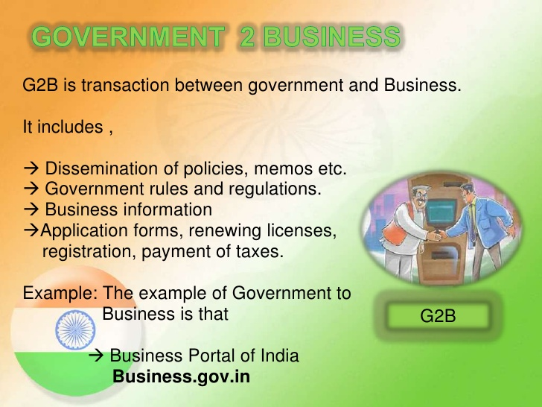

Slide 23
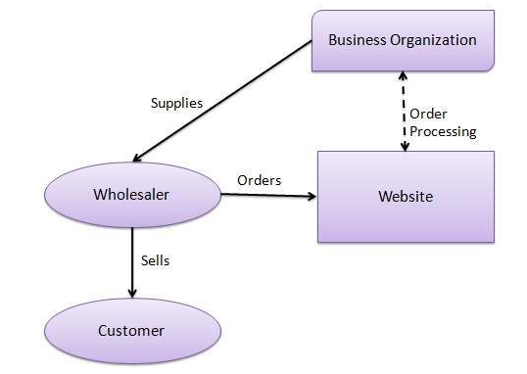
Business - to - Business

Slide 24
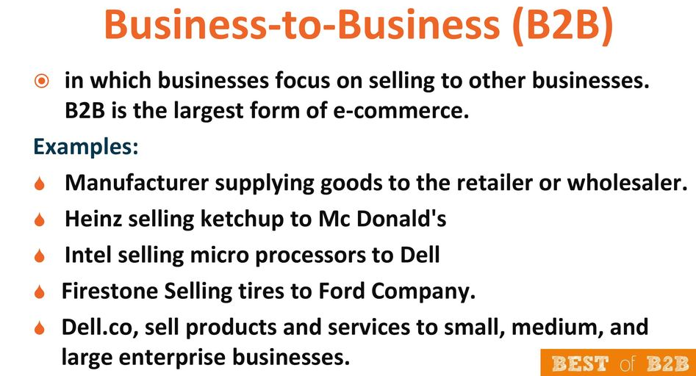

Slide 25
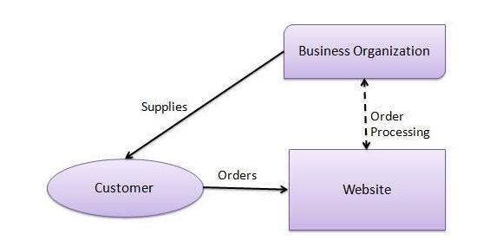
Business - to - Consumer

Slide 26
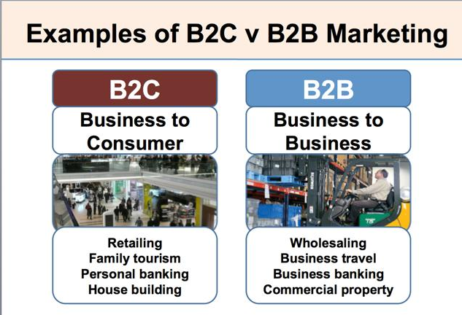

Slide 27
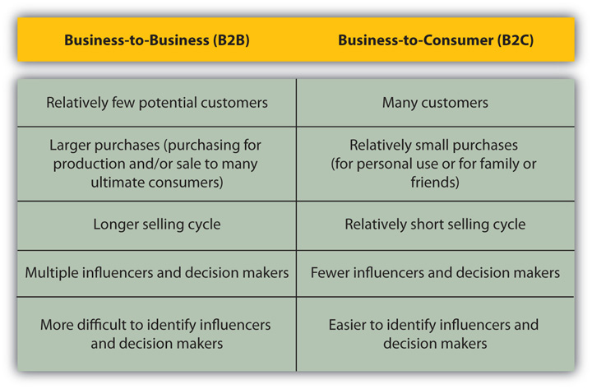

Slide 28
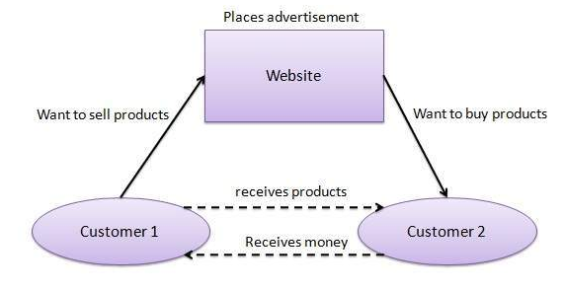
Consumer - to - Consumer

Slide 29
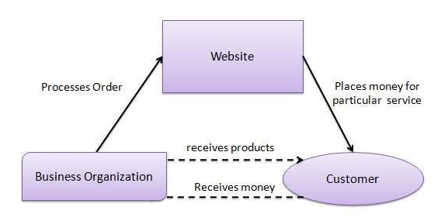
Consumer - to - Business

Slide 30
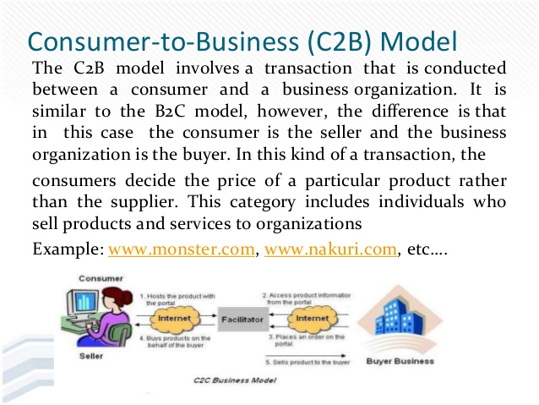

Slide 31
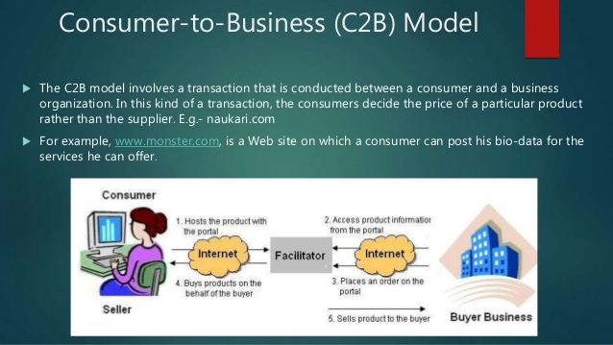

Slide 32
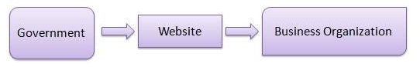
Government - to - Business

Slide 33
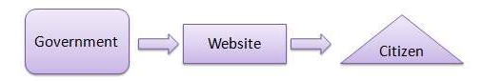
Government - to - Citizen

Slide 34
Major E-Commerce Mechanisms
Electronic catalogs
Electronic auctions
E-storefronts
E-malls
E-marketplaces
Notes:
Auction: a competitive buying and selling process in which prices are determined dynamically by competitive bidding.
Forward Auctions: sellers solicit bids from many potential buyers and prices tend to increase over time.
Reverse Auctions: one buyer, usually an organization, wants to purchase a product or a service and buyer posts a request for quotation (RFQ) on its Web site or on a third party site. Prices tend to decrease over time.
Electronic Storefront: a Web site that represents a single store.
Electronic Mall: (also known as a cybermall or an e-mall) a collection of individual shops consolidated under one Internet address and they are closely associated with B2C electronic commerce.
Electronic Marketplace (e-marketplace): a central, virtual market space on the Web where many buyers and many sellers can conduct e-commerce and e-business activities.

Slide 35
Major E-Commerce Mechanisms
Auction: a competitive buying and selling process in which prices are determined dynamically by competitive bidding.
Forward Auctions: sellers ask bids from many potential buyers and prices tend to increase over time.
Reverse Auctions: one buyer, usually an organization, wants to purchase a product or a service and buyer posts a request for quotation (RFQ) on its Web site or on a third party site. Prices tend to decrease over time.
Electronic Storefront: a Web site that represents a single store.
Electronic Mall: (also known as a cybermall or an e-mall) a collection of individual shops consolidated under one Internet address and they are closely associated with B2C electronic commerce.
Electronic Marketplace (e-marketplace): a central, virtual market space on the Web where many buyers and many sellers can conduct e-commerce and e-business activities.
Notes:
Auction: a competitive buying and selling process in which prices are determined dynamically by competitive bidding.
Forward Auctions: sellers solicit bids from many potential buyers and prices tend to increase over time.
Reverse Auctions: one buyer, usually an organization, wants to purchase a product or a service and buyer posts a request for quotation (RFQ) on its Web site or on a third party site. Prices tend to decrease over time.
Electronic Storefront: a Web site that represents a single store.
Electronic Mall: (also known as a cybermall or an e-mall) a collection of individual shops consolidated under one Internet address and they are closely associated with B2C electronic commerce.
Electronic Marketplace (e-marketplace): a central, virtual market space on the Web where many buyers and many sellers can conduct e-commerce and e-business activities.

Slide 36
Electronic Payment Mechanisms
Electronic Checks
Electronic Cards
Virtual Credit Cards
Purchasing Cards
Stored-Value Money Cards
Smart Cards
Person-to-Person Payments
Notes:
Electronic Payment Mechanisms: enable buyers to pay for goods and services electronically, rather than writing a check or using cash.
Electronic Checks: (e-checks), which are used primarily in B2B, are similar to regular paper checks.
Electronic Cards: There are a variety of electronic cards, and they are used for different purposes. The most common types are electronic credit cards, virtual credit cards, purchasing cards, stored-value money cards, and smart cards.
Virtual Credit Cards: allow customers to shop online and can be used only once in order to thwart criminals by using a different, random card number every time you shop online.
Purchasing Cards: are the B2B equivalent of electronic credit cards and in some countries, purchasing cards are the primary form of payment between companies.
Stored-Value Money Cards: allow you to store a fixed amount of prepaid money and then spend it as necessary and each time you use the card, the amount is reduced by the amount you spent.
Smart Cards: contain a chip that can store a considerable amount of information—more than 100 times the amount contained on a stored-value money card and are frequently multipurpose. That is, you can use them as a credit card, a debit card, a stored-value money card, or a loyalty card.
Person-to-Person Payments: enable two individuals, or an individual and a business, to transfer funds without using a credit card (e.g., PayPal).

Slide 37
Electronic Payment Mechanisms
Electronic Payment Mechanisms: enable buyers to pay for goods and services electronically, rather than writing a check or using cash.
Electronic Checks: (e-checks), which are used primarily in B2B, are similar to regular paper checks.
Electronic Cards: There are a variety of electronic cards, and they are used for different purposes. The most common types are electronic credit cards, virtual credit cards, purchasing cards, stored-value money cards, and smart cards.
Virtual Credit Cards: allow customers to shop online and can be used only once in order to thwart criminals by using a different, random card number every time you shop online.
Purchasing Cards: are the B2B equivalent of electronic credit cards and in some countries, purchasing cards are the primary form of payment between companies.
Stored-Value Money Cards: allow you to store a fixed amount of prepaid money and then spend it as necessary and each time you use the card, the amount is reduced by the amount you spent.
Smart Cards: contain a chip that can store a considerable amount of information—more than 100 times the amount contained on a stored-value money card and are frequently multipurpose. That is, you can use them as a credit card, a debit card, a stored-value money card, or a loyalty card.
Person-to-Person Payments: enable two individuals, or an individual and a business, to transfer funds without using a credit card (e.g., PayPal).
Notes:
Electronic Payment Mechanisms: enable buyers to pay for goods and services electronically, rather than writing a check or using cash.
Electronic Checks: (e-checks), which are used primarily in B2B, are similar to regular paper checks.
Electronic Cards: There are a variety of electronic cards, and they are used for different purposes. The most common types are electronic credit cards, virtual credit cards, purchasing cards, stored-value money cards, and smart cards.
Virtual Credit Cards: allow customers to shop online and can be used only once in order to thwart criminals by using a different, random card number every time you shop online.
Purchasing Cards: are the B2B equivalent of electronic credit cards and in some countries, purchasing cards are the primary form of payment between companies.
Stored-Value Money Cards: allow you to store a fixed amount of prepaid money and then spend it as necessary and each time you use the card, the amount is reduced by the amount you spent.
Smart Cards: contain a chip that can store a considerable amount of information—more than 100 times the amount contained on a stored-value money card and are frequently multipurpose. That is, you can use them as a credit card, a debit card, a stored-value money card, or a loyalty card.
Person-to-Person Payments: enable two individuals, or an individual and a business, to transfer funds without using a credit card (e.g., PayPal).

Slide 38
Electronic Payment Mechanisms
Electronic Payment Mechanisms: enable buyers to pay for goods and services electronically, rather than writing a check or using cash.
Electronic Checks: (e-checks), which are used primarily in B2B, are similar to regular paper checks.
Electronic Cards: There are a variety of electronic cards, and they are used for different purposes. The most common types are electronic credit cards, virtual credit cards, purchasing cards, stored-value money cards, and smart cards.
Virtual Credit Cards: allow customers to shop online and can be used only once in order to thwart criminals by using a different, random card number every time you shop online.
Stored-Value Money Cards: allow you to store a fixed amount of prepaid money and then spend it as necessary and each time you use the card, the amount is reduced by the amount you spent.
Smart Cards: contain a chip that can store a considerable amount of information—more than 100 times the amount contained on a stored-value money card and are frequently multipurpose. That is, you can use them as a credit card, a debit card, a stored-value money card, or a loyalty card.
Person-to-Person Payments: enable two individuals, or an individual and a business, to transfer funds without using a credit card (e.g., PayPal).
Notes:
Electronic Payment Mechanisms: enable buyers to pay for goods and services electronically, rather than writing a check or using cash.
Electronic Checks: (e-checks), which are used primarily in B2B, are similar to regular paper checks.
Electronic Cards: There are a variety of electronic cards, and they are used for different purposes. The most common types are electronic credit cards, virtual credit cards, purchasing cards, stored-value money cards, and smart cards.
Virtual Credit Cards: allow customers to shop online and can be used only once in order to thwart criminals by using a different, random card number every time you shop online.
Purchasing Cards: are the B2B equivalent of electronic credit cards and in some countries, purchasing cards are the primary form of payment between companies.
Stored-Value Money Cards: allow you to store a fixed amount of prepaid money and then spend it as necessary and each time you use the card, the amount is reduced by the amount you spent.
Smart Cards: contain a chip that can store a considerable amount of information—more than 100 times the amount contained on a stored-value money card and are frequently multipurpose. That is, you can use them as a credit card, a debit card, a stored-value money card, or a loyalty card.
Person-to-Person Payments: enable two individuals, or an individual and a business, to transfer funds without using a credit card (e.g., PayPal).

Slide 39
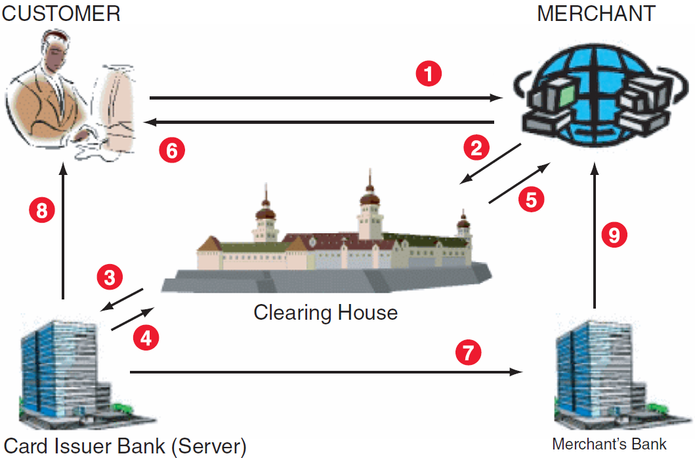
Figure 9.1: How e-credit cards work

Slide 40
Benefits of E-Commerce
Organization Benefit: national and international markets more accessible by lowering the costs of processing, distributing, and retrieving information.
Customer Benefit: by being able to access a vast number of products and services, around the clock.
Benefit to Society: the ability to easily and conveniently deliver information, services, and products to people in cities, rural areas, and developing countries.
Notes:
Organization Benefit: national and international markets more accessible by lowering the costs of processing, distributing, and retrieving information.
Customer Benefit: by being able to access a vast number of products and services, around the clock.
Benefit to Society: the ability to easily and conveniently deliver information, services, and products to people in cities, rural areas, and developing countries.

Slide 41
Benefits of E-Commerce
Organization Benefit
Customer Benefit
Benefit to Society
Notes:
Organization Benefit: national and international markets more accessible by lowering the costs of processing, distributing, and retrieving information.
Customer Benefit: by being able to access a vast number of products and services, around the clock.
Benefit to Society: the ability to easily and conveniently deliver information, services, and products to people in cities, rural areas, and developing countries.

Slide 42
Advantages to Organizations
Using e-commerce, organizations can expand their market to national and international markets with minimum capital investment. An organization can easily locate more customers, best suppliers, and suitable business partners across the globe.
E-commerce helps organizations to reduce the cost to create process, distribute, retrieve and manage the paper based information by digitizing the information.
E-commerce improves the brand image of the company.
E-commerce helps organization to provide better customer services.
E-commerce helps to simplify the business processes and makes them faster and efficient.
E-commerce reduces the paper work.
E-commerce increases the productivity of organizations. It supports "pull" type supply management. In "pull" type supply management, a business process starts when a request comes from a customer and it uses just-in-time manufacturing way.

Slide 43
Advantages to Customers
It provides 24x7 support. Customers can enquire about a product or service and place orders anytime, anywhere from any location.
E-commerce application provides users with more options and quicker delivery of products.
E-commerce application provides users with more options to compare and select the cheaper and better options.
A customer can put review comments about a product and can see what others are buying, or see the review comments of other customers before making a final purchase.
E-commerce provides options of virtual auctions.
It provides readily available information. A customer can see the relevant detailed information within seconds, rather than waiting for days or weeks.
E-Commerce increases the competition among organizations and as a result, organizations provides substantial discounts to customers.

Slide 44
Advantages to Society
Customers need not travel to shop a product, thus less traffic on road and low air pollution.
E-commerce helps in reducing the cost of products, so less affluent people can also afford the products.
E-commerce has enabled rural areas to access services and products, which are otherwise not available to them.
E-commerce helps the government to deliver public services such as healthcare, education, social services at a reduced cost and in an improved manner.

Slide 45
E-Commerce - Disadvantages
The disadvantages of e-commerce can be broadly classified into two major categories −
Technical disadvantages
Non-Technical disadvantages

Slide 46
Technical Disadvantages
There can be lack of system security, reliability or standards owing to poor implementation of e-commerce.
The software development industry is still evolving and keeps changing rapidly.
In many countries, network bandwidth might cause an issue.
Special types of web servers or other software might be required by the vendor, setting the e-commerce environment apart from network servers.
Sometimes, it becomes difficult to integrate an e-commerce software or website with existing applications or databases.
There could be software/hardware compatibility issues, as some e-commerce software may be incompatible with some operating system or any other component.

Slide 47
Non-Technical Disadvantages
Initial Cost - The cost of creating/building an e-commerce application in-house may be very high. There could be delays in launching an e-Commerce application due to mistakes, and lack of experience.
User resistance − Users may not trust the site being an unknown faceless seller. Such mistrust makes it difficult to convince traditional users to switch from physical stores to online/virtual stores.
Security/ Privacy − It is difficult to ensure the security or privacy on online transactions.
Lack of touch or feel of products during online shopping is a drawback.
E-commerce applications are still evolving and changing rapidly.

Slide 48
Limitations of E-Commerce
Technological Limitations:
Lack of universally accepted security standards
In less-developed countries, telecommunications bandwidth often is insufficient, and accessing the Web is expensive.
Non-technological Limitations of E-Commerce:
Perceptions that EC is insecure
EC has unresolved legal issues
EC lacks a critical mass of sellers and buyers.
Notes:
Technological Limitations:
Lack of universally accepted security standards
In less-developed countries, telecommunications bandwidth often is insufficient, and accessing the Web is expensive.
Non-technological Limitations of E-Commerce:
Perceptions that EC is insecure
EC has unresolved legal issues
EC lacks a critical mass of sellers and buyers.

Slide 49
’S ABOUT BUSINESS 9.2
Overcoming the Limitations of E-Commerce in the Developing World
Describe how the Young Village Officials Farm and Jumia are trying to overcome the limitations of electronic commerce. Provide specific examples to support your answer.
What are the advantages of electronic commerce to rural farmers in China (above and beyond increased income)?
What are the advantages of electronic commerce to the people of Nigeria?

Slide 50
9.2
Business-to-Consumer (B2C) Electronic Commerce
Electronic Storefront: a Web site that represents a single store.
Electronic Mall: (also known as a cybermall or an e-mall) a collection of individual shops grouped under a single Internet address.
Online Advertising: the practice of using the Internet and WWW to disseminate information in an attempt to influence a buyer–seller transaction through the direct response approach which personalizes advertising and marketing making the advertising process media rich, dynamic, and interactive.
Notes:
Electronic Storefront: a Web site that represents a single store.
Electronic Mall: (also known as a cybermall or an e-mall) a collection of individual shops grouped under a single Internet address.
Online Advertising: the practice of using the Internet and WWW to disseminate information in an attempt to influence a buyer–seller transaction through the direct response approach which personalizes advertising and marketing making the advertising process media rich, dynamic, and interactive.

Slide 51
Electronic Storefronts and Malls
Electronic Retailing (e-tailing)
Electronic Storefront
Electronic Mall
Notes:
Electronic Retailing (e-tailing): the direct sale of products and services through electronic storefronts or electronic malls, usually designed around an electronic catalog format and/or auctions.
Electronic Storefront: a Web site that represents a single store.
Electronic Mall: (also known as a cybermall or an e-mall) a collection of individual shops grouped under a single Internet address.
Two Types of Cybermalls:
Referral Malls: (e.g., www.hawaii.com), you cannot buy anything, but instead, you are transferred from the mall to a participating storefront.
A Cybermall (e.g., http://shopping .google.com) where you can actually make a purchase. You might shop from several stores, but you make only one purchase transaction at the end.

Slide 52
Electronic Storefronts and Malls
Electronic Retailing (e-tailing): the direct sale of products and services through electronic storefronts or electronic malls, usually designed around an electronic catalog format and/or auctions.
Electronic Storefront: a Web site that represents a single store.
Electronic Mall: (also known as a cybermall or an e-mall) a collection of individual shops grouped under a single Internet address.
Two Types of Cybermalls:
Referral Malls: (e.g., www.hawaii.com), you cannot buy anything, but instead, you are transferred from the mall to a participating storefront.
A Cybermall (e.g., http://shopping .google.com) where you can actually make a purchase. You might shop from several stores, but you make only one purchase transaction at the end.
Notes:
Electronic Retailing (e-tailing): the direct sale of products and services through electronic storefronts or electronic malls, usually designed around an electronic catalog format and/or auctions.
Electronic Storefront: a Web site that represents a single store.
Electronic Mall: (also known as a cybermall or an e-mall) a collection of individual shops grouped under a single Internet address.
Two Types of Cybermalls:
Referral Malls: (e.g., www.hawaii.com), you cannot buy anything, but instead, you are transferred from the mall to a participating storefront.
A Cybermall (e.g., http://shopping .google.com) where you can actually make a purchase. You might shop from several stores, but you make only one purchase transaction at the end.

Slide 53
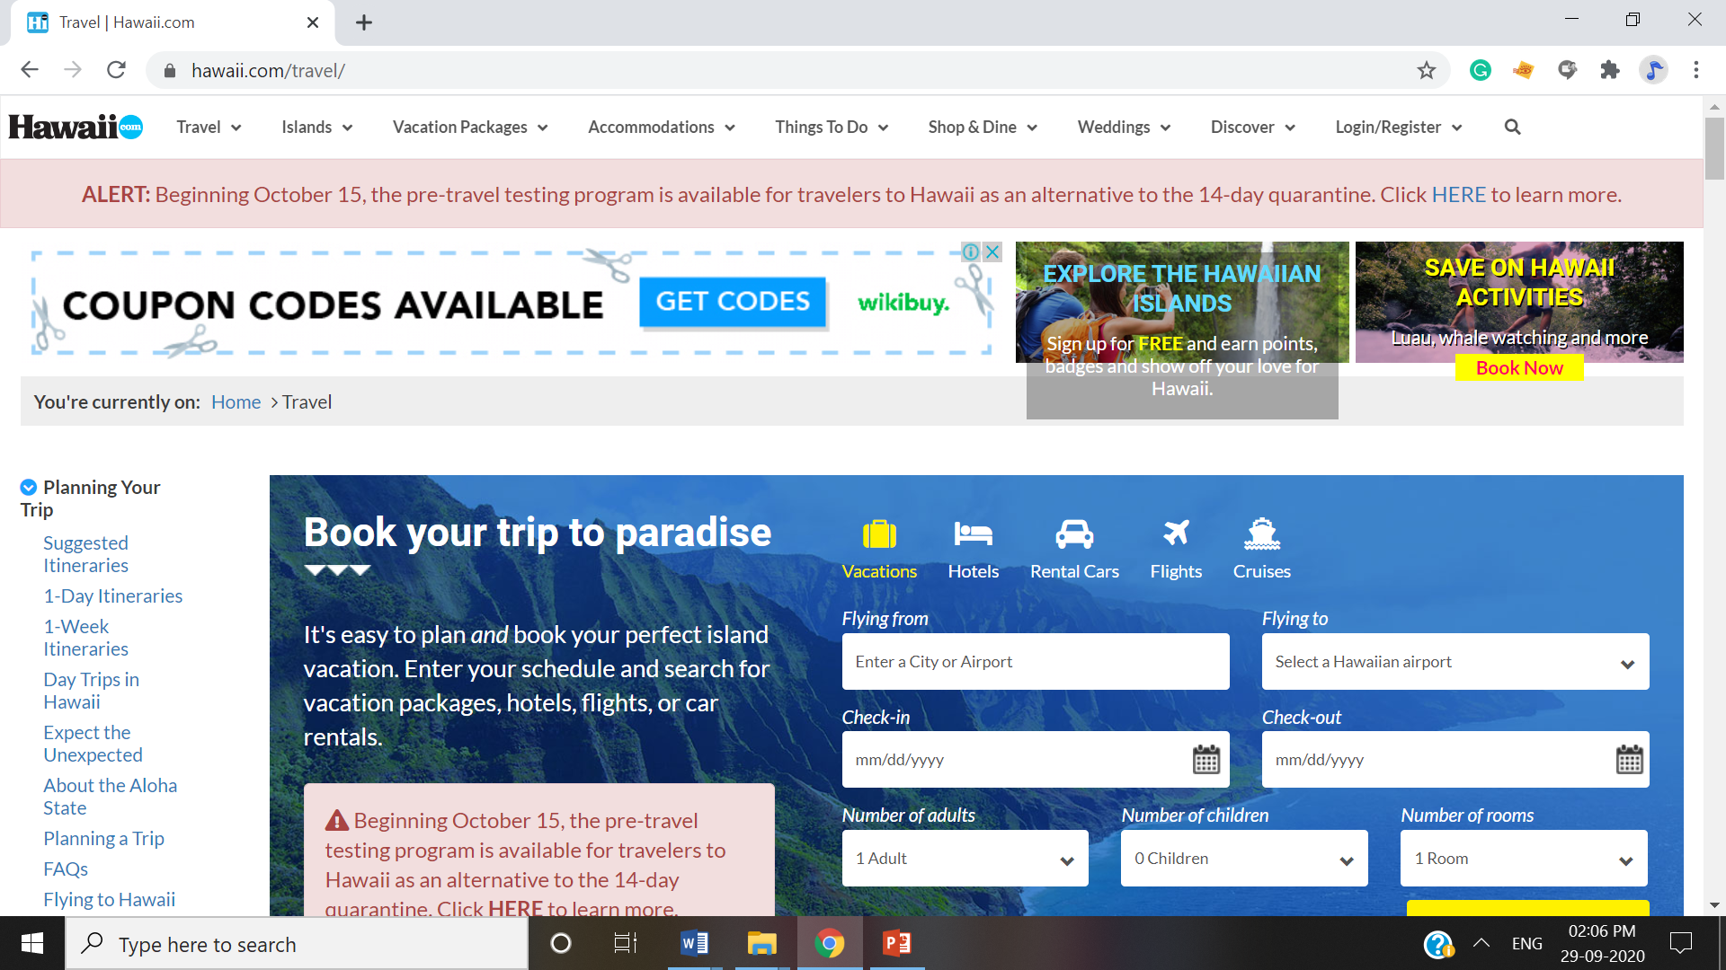
Referral Mall

Slide 54
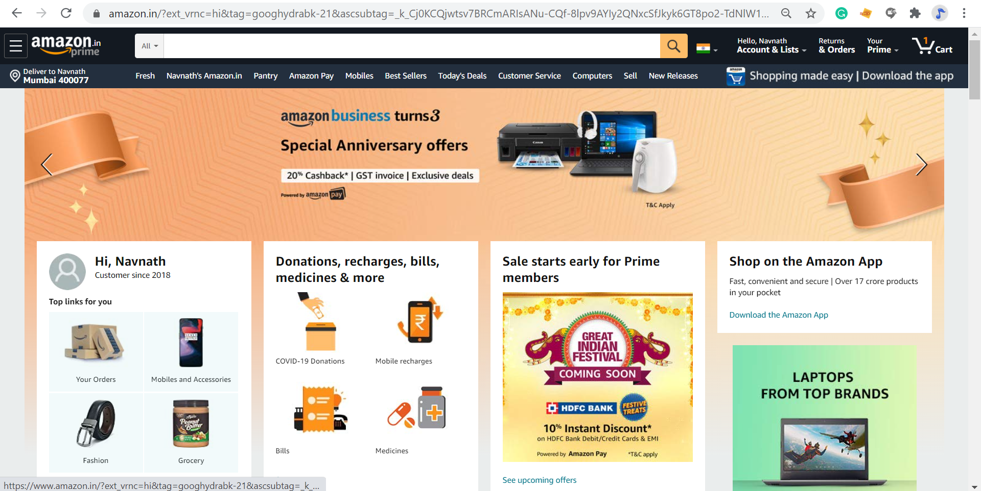
Cybermall

Slide 55
Online Service Industries
Disintermediation
Cyberbanking
Online Securities Trading
The Online Job Market
Travel Services
Online Advertising
Advertising Methods
Notes:
Disintermediation: a process whereby intermediaries are eliminated.
Intermediaries (or middlemen) Have Two Functions:
they provide information, and this function can be fully automated and most likely will be assumed by e-marketplaces and portals that provide information for free.
they perform value-added services such as consulting.
Cyberbanking (or Electronic Banking): involves conducting various banking activities from home, at a place of business, or on the road instead of at a physical bank location. It include capabilities ranging from paying bills to applying for a loan.
Online Securities Trading: the use of computers to trade stocks, bonds, and other financial instruments. (e.g., E*Trade, Ameritrade, etc.) which is cheaper than a full-service or discount broker.
Online Job Market: Companies and government agencies advertise available positions, accept resumes, and take applications via the Internet while job seekers use the online job market to reply online to employment ads, to place resumes on various sites, and to use recruiting firms (e.g., www.monster.com, www.simplyhired.com, www.linkedin.com, and www.truecareers.com).
Travel Services: use of the Internet and WWW to plan, explore, and arrange almost any trip economically allowing customers to purchase airline tickets, reserve hotel rooms, and rent cars.
Online Advertising: the practice of using the Internet and WWW to disseminate information in an attempt to influence a buyer–seller transaction through the direct response approach which personalizes advertising and marketing making the advertising process media rich, dynamic, and interactive.

Slide 56
Online Service Industries
Intermediaries (or middlemen) Have Two Functions:
They provide information, and this function can be fully automated and most likely will be assumed by e-marketplaces and portals that provide information for free.
They perform value-added services such as consulting.
Disintermediation: a process whereby intermediaries are eliminated.
Cyberbanking (or Electronic Banking): involves conducting various banking activities from home, at a place of business, or on the road instead of at a physical bank location. It include capabilities ranging from paying bills to applying for a loan.
Notes:
Disintermediation: a process whereby intermediaries are eliminated.
Intermediaries (or middlemen) Have Two Functions:
they provide information, and this function can be fully automated and most likely will be assumed by e-marketplaces and portals that provide information for free.
they perform value-added services such as consulting.
Cyberbanking (or Electronic Banking): involves conducting various banking activities from home, at a place of business, or on the road instead of at a physical bank location. It include capabilities ranging from paying bills to applying for a loan.
Online Securities Trading: the use of computers to trade stocks, bonds, and other financial instruments. (e.g., E*Trade, Ameritrade, etc.) which is cheaper than a full-service or discount broker.
Online Job Market: Companies and government agencies advertise available positions, accept resumes, and take applications via the Internet while job seekers use the online job market to reply online to employment ads, to place resumes on various sites, and to use recruiting firms (e.g., www.monster.com, www.simplyhired.com, www.linkedin.com, and www.truecareers.com).
Travel Services: use of the Internet and WWW to plan, explore, and arrange almost any trip economically allowing customers to purchase airline tickets, reserve hotel rooms, and rent cars.
Online Advertising: the practice of using the Internet and WWW to disseminate information in an attempt to influence a buyer–seller transaction through the direct response approach which personalizes advertising and marketing making the advertising process media rich, dynamic, and interactive.

Slide 57
Online Service Industries
Online Job Market: Companies and government agencies advertise available positions, accept resumes, and take applications via the Internet while job seekers use the online job market to reply online to employment ads, to place resumes on various sites, and to use recruiting firms (e.g., www.monster.com, www.simplyhired.com, www.linkedin.com, and www.truecareers.com).
Travel Services: use of the Internet and WWW to plan, explore, and arrange almost any trip economically allowing customers to purchase airline tickets, reserve hotel rooms, and rent cars.
Notes:
Disintermediation: a process whereby intermediaries are eliminated.
Intermediaries (or middlemen) Have Two Functions:
they provide information, and this function can be fully automated and most likely will be assumed by e-marketplaces and portals that provide information for free.
they perform value-added services such as consulting.
Cyberbanking (or Electronic Banking): involves conducting various banking activities from home, at a place of business, or on the road instead of at a physical bank location. It include capabilities ranging from paying bills to applying for a loan.
Online Securities Trading: the use of computers to trade stocks, bonds, and other financial instruments. (e.g., E*Trade, Ameritrade, etc.) which is cheaper than a full-service or discount broker.
Online Job Market: Companies and government agencies advertise available positions, accept resumes, and take applications via the Internet while job seekers use the online job market to reply online to employment ads, to place resumes on various sites, and to use recruiting firms (e.g., www.monster.com, www.simplyhired.com, www.linkedin.com, and www.truecareers.com).
Travel Services: use of the Internet and WWW to plan, explore, and arrange almost any trip economically allowing customers to purchase airline tickets, reserve hotel rooms, and rent cars.
Online Advertising: the practice of using the Internet and WWW to disseminate information in an attempt to influence a buyer–seller transaction through the direct response approach which personalizes advertising and marketing making the advertising process media rich, dynamic, and interactive.

Slide 58
Online Advertising
Online Advertising: the practice of using the Internet and WWW to disseminate information in an attempt to influence a buyer–seller transaction through the direct response approach which personalizes advertising and marketing making the advertising process media rich, dynamic, and interactive.
Advantages of Online Advertising:
Updated any time at minimal cost
Reach very large numbers of potential buyers all over the world
Generally cheaper than radio, television, and print ads
Interactive and targeted to specific interest groups and/or individuals
Notes:
Online Advertising: the practice of using the Internet and WWW to disseminate information in an attempt to influence a buyer–seller transaction through the direct response approach which personalizes advertising and marketing making the advertising process media rich, dynamic, and interactive.
Advantages of Online Advertising:
Updated any time at minimal cost
Reach very large numbers of potential buyers all over the world
Generally cheaper than radio, television, and print ads
Interactive and targeted to specific interest groups and/or individuals

Slide 59
Advertising Methods
Banner Ads
Pop-Up Ad
Pop-Under Ad
Spam
Permission Marketing
Viral Marketing
Notes:
Banner Ads: electronic billboards containing a short text, graphics, video clips, or sound to promote a product or a vendor.
Characteristics of Banner Ads:
the most common form of advertising on the Internet
customized to a target audience
convey only limited information because of their small size
many viewers simply ignore them
Pop-Up Ad: an Internet ad that appears in front of the current browser window.
Pop-Under Ad: an Internet ad appears underneath the active window; when users close the active window, they see the ad.
Spam: indiscriminate distribution of electronic ads without the permission of the receiver.
Permission Marketing: asks consumers to give their permission to voluntarily accept online advertising and e-mail.
Viral Marketing: online word-of-mouth marketing including messages forwarded to friends, family members, and other acquaintances suggesting they “check this out" which enables companies to build brand awareness at a minimal cost without having to spam millions of uninterested users.

Slide 60
Advertising Methods
Banner Ads: electronic billboards containing a short text, graphics, video clips, or sound to promote a product or a vendor.
Characteristics of Banner Ads:
the most common form of advertising on the Internet
customized to a target audience
convey only limited information because of their small size
many viewers simply ignore them
Notes:
Banner Ads: electronic billboards containing a short text, graphics, video clips, or sound to promote a product or a vendor.
Characteristics of Banner Ads:
the most common form of advertising on the Internet
customized to a target audience
convey only limited information because of their small size
many viewers simply ignore them
Pop-Up Ad: an Internet ad that appears in front of the current browser window.
Pop-Under Ad: an Internet ad appears underneath the active window; when users close the active window, they see the ad.
Spam: indiscriminate distribution of electronic ads without the permission of the receiver.
Permission Marketing: asks consumers to give their permission to voluntarily accept online advertising and e-mail.
Viral Marketing: online word-of-mouth marketing including messages forwarded to friends, family members, and other acquaintances suggesting they “check this out" which enables companies to build brand awareness at a minimal cost without having to spam millions of uninterested users.

Slide 61
Advertising Methods
Pop-Up Ad: an Internet ad that appears in front of the current browser window.
Pop-Under Ad: an Internet ad appears underneath the active window; when users close the active window, they see the ad.
Spam: indiscriminate distribution of electronic ads without the permission of the receiver.
Permission Marketing: asks consumers to give their permission to voluntarily accept online advertising and e-mail.
Viral Marketing: online word-of-mouth marketing including messages forwarded to friends, family members, and other acquaintances suggesting they “check this out" which enables companies to build brand awareness at a minimal cost without having to spam millions of uninterested users.
Notes:
Banner Ads: electronic billboards containing a short text, graphics, video clips, or sound to promote a product or a vendor.
Characteristics of Banner Ads:
the most common form of advertising on the Internet
customized to a target audience
convey only limited information because of their small size
many viewers simply ignore them
Pop-Up Ad: an Internet ad that appears in front of the current browser window.
Pop-Under Ad: an Internet ad appears underneath the active window; when users close the active window, they see the ad.
Spam: indiscriminate distribution of electronic ads without the permission of the receiver.
Permission Marketing: asks consumers to give their permission to voluntarily accept online advertising and e-mail.
Viral Marketing: online word-of-mouth marketing including messages forwarded to friends, family members, and other acquaintances suggesting they “check this out" which enables companies to build brand awareness at a minimal cost without having to spam millions of uninterested users.

Slide 62
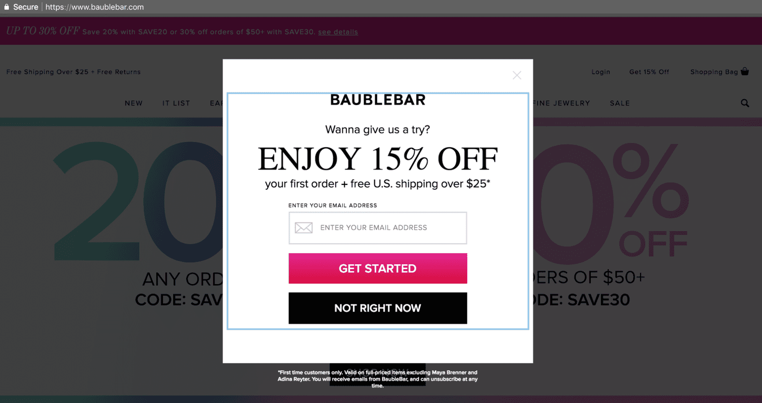
Pop up ads

Slide 63
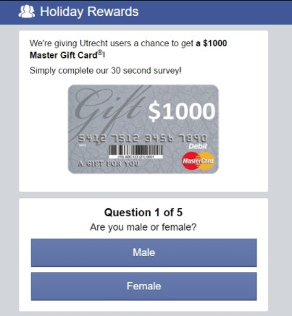

Pop under ads

Slide 64
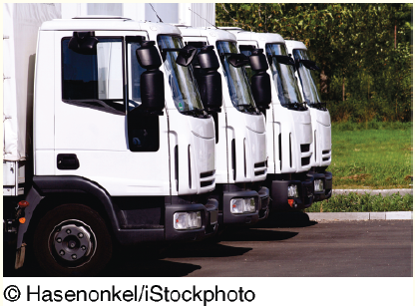
’S ABOUT BUSINESS 9.3
Penske Used Trucks
Describe how disintermediation works in this case. Provide an example to support your answer.
Why is it so important for different functional areas in an organization to work together in designing an organizational Web site?
Referencing question 2, discuss the implications of this statement: “Regardless of your major, an understanding of information technology will be of value to you.”

Slide 65
Issues in E-Tailing
Channel Conflict
Multi-channeling (Omni-channeling)
Showrooming
Order Fulfillment
Notes:
Two Most Significant E-Tailing Issues:
Channel Conflict
Fulfillment
Channel Conflict: a situation in which clicks-and-mortar companies face a conflict with their regular distributors when they begin selling directly to customers online. These conflicts can arise in areas such as pricing, resource allocation (e.g., how much money to spend on advertising).
Multichanneling (or omni-channeling): a process in which companies integrate their online and offline channels creating the opportunity for 'showrooming.'
Showrooming: occurs when shoppers visit a brick-and-mortar store to examine a product in person then conduct research about the product on their smartphones. In these situations customers often purchase the product from the Web site of a competitor of the store they are visiting.
Order Fulfillment: when a company sells directly to customers, it is involved in various order-fulfillment activities including: quickly finding the products to be shipped; packing orders; arranging for the packages to be delivered speedily to the customer’s door; collect the money from each customer; handle the return of unwanted or defective products.

Slide 66
Issues in E-Tailing
Two Most Significant E-Tailing Issues:
Channel Conflict
Fulfillment
Channel Conflict: a situation in which clicks-and-mortar companies face a conflict with their regular distributors when they begin selling directly to customers online. These conflicts can arise in areas such as pricing, resource allocation (e.g., how much money to spend on advertising).
Multichanneling (or omni-channeling): a process in which companies integrate their online and offline channels creating the opportunity for 'showrooming.'
Showrooming: occurs when shoppers visit a brick-and-mortar store to examine a product in person then conduct research about the product on their smartphones. In these situations customers often purchase the product from the Web site of a competitor of the store they are visiting.
Notes:
Two Most Significant E-Tailing Issues:
Channel Conflict
Fulfillment
Channel Conflict: a situation in which clicks-and-mortar companies face a conflict with their regular distributors when they begin selling directly to customers online. These conflicts can arise in areas such as pricing, resource allocation (e.g., how much money to spend on advertising).
Multichanneling (or omni-channeling): a process in which companies integrate their online and offline channels creating the opportunity for 'showrooming.'
Showrooming: occurs when shoppers visit a brick-and-mortar store to examine a product in person then conduct research about the product on their smartphones. In these situations customers often purchase the product from the Web site of a competitor of the store they are visiting.
Order Fulfillment: when a company sells directly to customers, it is involved in various order-fulfillment activities including: quickly finding the products to be shipped; packing orders; arranging for the packages to be delivered speedily to the customer’s door; collect the money from each customer; handle the return of unwanted or defective products.

Slide 67
Issues in E-Tailing
Order Fulfillment: when a company sells directly to customers, it is involved in various order-fulfillment activities including:
quickly finding the products to be shipped
packing orders
arranging for the packages to be delivered speedily to the customer’s door
collect the money from each customer
handle the return of unwanted or defective products.
Notes:
Two Most Significant E-Tailing Issues:
Channel Conflict
Fulfillment
Channel Conflict: a situation in which clicks-and-mortar companies face a conflict with their regular distributors when they begin selling directly to customers online. These conflicts can arise in areas such as pricing, resource allocation (e.g., how much money to spend on advertising).
Multichanneling (or omni-channeling): a process in which companies integrate their online and offline channels creating the opportunity for 'showrooming.'
Showrooming: occurs when shoppers visit a brick-and-mortar store to examine a product in person then conduct research about the product on their smartphones. In these situations customers often purchase the product from the Web site of a competitor of the store they are visiting.
Order Fulfillment: when a company sells directly to customers, it is involved in various order-fulfillment activities including: quickly finding the products to be shipped; packing orders; arranging for the packages to be delivered speedily to the customer’s door; collect the money from each customer; handle the return of unwanted or defective products.

Slide 68
’S ABOUT BUSINESS 9.4
Can Simple Disrupt Traditional Banking?
Would you be willing to bank with an Internet bank? Why or why not?
What are the disadvantages of Simple’s banking model? Provide examples to support your answer.

Slide 69
9.3
Business-to-Business (B2B) Electronic Commerce
Sell-Side Marketplace Model
Buy-Side Marketplaces Model
Notes:
Sell-Side Marketplace Model: organizations attempt to sell their products or services to other organizations electronically from their own private e-marketplace Web site and/or from a third-party Web site. In the B2B sell-side marketplace the buyer is an organization.
Buy-Side Marketplaces Model: a model in which organizations attempt to procure needed products or services from other organizations electronically. Procurement is the overarching function that describes the activities and processes to acquire goods and services.

Slide 70
Sell-Side Marketplaces
Sell-Side Marketplace Model: organizations attempt to sell their products or services to other organizations electronically from their own private e-marketplace Web site and/or from a third-party Web site. In the B2B sell-side marketplace the buyer is an organization.
Key Mechanisms in the Sell-Side Marketplace Model:
Forward auctions
Electronic catalogs customized for each large buyer
Third-Party Auction Sites (e.g., eBay)
Notes:
Sell-Side Marketplace Model: organizations attempt to sell their products or services to other organizations electronically from their own private e-marketplace Web site and/or from a third-party Web site. In the B2B sell-side marketplace the buyer is an organization.
Key Mechanisms in the Sell-Side Marketplace Model:
Forward auctions
Electronic catalogs customized for each large buyer
Third-Party Auction Sites (e.g., eBay)

Slide 71
Buy-Side Marketplaces
Buy-Side Marketplaces Model: a model in which organizations attempt to procure needed products or services from other organizations electronically. Procurement is the main function that describes the activities and processes to acquire goods and services.
Procurement: involves the activities necessary to establish requirements, sourcing activities such as market research and vendor evaluation, and negotiation of contracts.
Purchasing: the process of ordering and receiving goods and services and it is a subset of the procurement process.
Reverse Auction: A major method of procuring goods and services in the buy-side model is the reverse auction.
E-procurement: uses reverse auctions, particularly group purchasing.
Group Purchasing: multiple buyers combine their orders so that they constitute a large volume and therefore attract more seller attention and when buyers place their combined orders on a reverse auction, they can negotiate a volume discount.
Notes:
Buy-Side Marketplaces Model: a model in which organizations attempt to procure needed products or services from other organizations electronically. Procurement is the overarching function that describes the activities and processes to acquire goods and services.
Procurement: involves the activities necessary to establish requirements, sourcing activities such as market research and vendor evaluation, and negotiation of contracts.
Purchasing: the process of ordering and receiving goods and services and it is a subset of the procurement process.
Reverse Auction: A major method of procuring goods and services in the buy-side model is the reverse auction.
E-procurement: uses reverse auctions, particularly group purchasing.
Group Purchasing: multiple buyers combine their orders so that they constitute a large volume and therefore attract more seller attention and when buyers place their combined orders on a reverse auction, they can negotiate a volume discount.

Slide 72
Electronic Exchanges
Private Exchanges: have one buyer and many sellers.
Public Exchanges: Electronic marketplaces that are independently owned by a third party, and they connect many sellers with many buyers which are open to all business organizations and frequently owned and operated by a third party.
Electronic Exchanges: deal in both direct and indirect materials.
Direct Materials: inputs to the manufacturing process, such as safety glass used in automobile windshields and windows.
Indirect Materials: those items, such as office supplies, that are needed for maintenance, operations, and repairs (MRO).
Notes:
Private Exchanges: have one buyer and many sellers.
Public Exchanges: Electronic marketplaces that are independently owned by a third party, and they connect many sellers with many buyers which are open to all business organizations and frequently owned and operated by a third party.
Electronic Exchanges: deal in both direct and indirect materials.
Direct Materials: inputs to the manufacturing process, such as safety glass used in automobile windshields and windows.
Indirect Materials: those items, such as office supplies, that are needed for maintenance, operations, and repairs (MRO).
Three Basic Types of Public Exchanges:
Vertical Exchanges: connect buyers and sellers in a given industry.
Horizontal Exchanges: connect buyers and sellers across many industries.
Functional Exchanges: needed services such as temporary help/labor or extra office space are traded on an “as-needed” basis.

Slide 73
Electronic Exchanges
Three Basic Types of Public Exchanges:
Vertical Exchanges: connect buyers and sellers in a given industry.
Horizontal Exchanges: connect buyers and sellers across many industries.
Functional Exchanges: needed services such as temporary help/labor or extra office space are traded on an “as-needed” basis.
Notes:
Private Exchanges: have one buyer and many sellers.
Public Exchanges: Electronic marketplaces that are independently owned by a third party, and they connect many sellers with many buyers which are open to all business organizations and frequently owned and operated by a third party.
Electronic Exchanges: deal in both direct and indirect materials.
Direct Materials: inputs to the manufacturing process, such as safety glass used in automobile windshields and windows.
Indirect Materials: those items, such as office supplies, that are needed for maintenance, operations, and repairs (MRO).
Three Basic Types of Public Exchanges:
Vertical Exchanges: connect buyers and sellers in a given industry.
Horizontal Exchanges: connect buyers and sellers across many industries.
Functional Exchanges: needed services such as temporary help/labor or extra office space are traded on an “as-needed” basis.

